Slide 1

Deep Learning Techniques in Load Forecasting
Presented By:- Tolulope Olugbenga

Slide 2
Outline
Introduction
Description of the models
Dataset
One Week’s forecast
Two Weeks forecast
One Month forecast
December, 2017’s forecast
Challenges / Observations
Conclusions

Slide 3
Introduction
Electricity is one of the driving forces of economic development and is essential to our daily life and wellbeing.
Load forecasting is an integral part in the process of the planning and operation of electric utilities; it has played a vital role in the power industry for over a century. In terms of power supply and demand; for the stable supply of electricity, the reserve power must be prepared.
Businesses needs of load forecasting includes power systems planning/operations, revenue projection, rate design, energy trading, and so on.
The demand pattern is very complex due to the deregulation of energy markets; therefore finding an appropriate forecasting model for a specific electricity network is not a trivial task.

Slide 4
Description of the models
In this project 6 models were explored; simple average, moving average, naive approach, holt-winter method, auto regressive model (AR), and auto regressive integrated moving average (ARIMA). They were used to predict; one week ahead, two weeks ahead, one month ahead, and the demand for December, 2017; and their results were evaluated.
The simple average approach takes the sum of all occurrences in the data and divides it by the number of the occurrences.
The moving average approach takes the average of previous fixed n observations and uses it as a prediction for the next day.
The naive approach predicts the current observation as the previously observed value; due to weekly similarity of the data, the naive approach implemented in this project takes the previous week’s value, e.g. this Tuesday is similar with last Tuesday.

Slide 5
Description of the models
Holt-Winters forecasting method is a way to model and predict the behavior of the previous data. This method models three aspects of the data; the average, the trend, and the seasonality (repeating pattern).
The autoregressive model is used when there are some correlation between the values in a time series. The process is basically a linear regression of the data in the current series against one or more past values in the same series.
An ARIMA model is characterized by p, d, q; where p is the order of the AR term, q is the order of the MA term, and d is the number of differencing required in order to make the time series stationary. The SARIMA takes into account the seasonality of the dataset; seasonal differencing is similar to regular differencing, but instead it subtracts the value from the previous season.

Slide 6
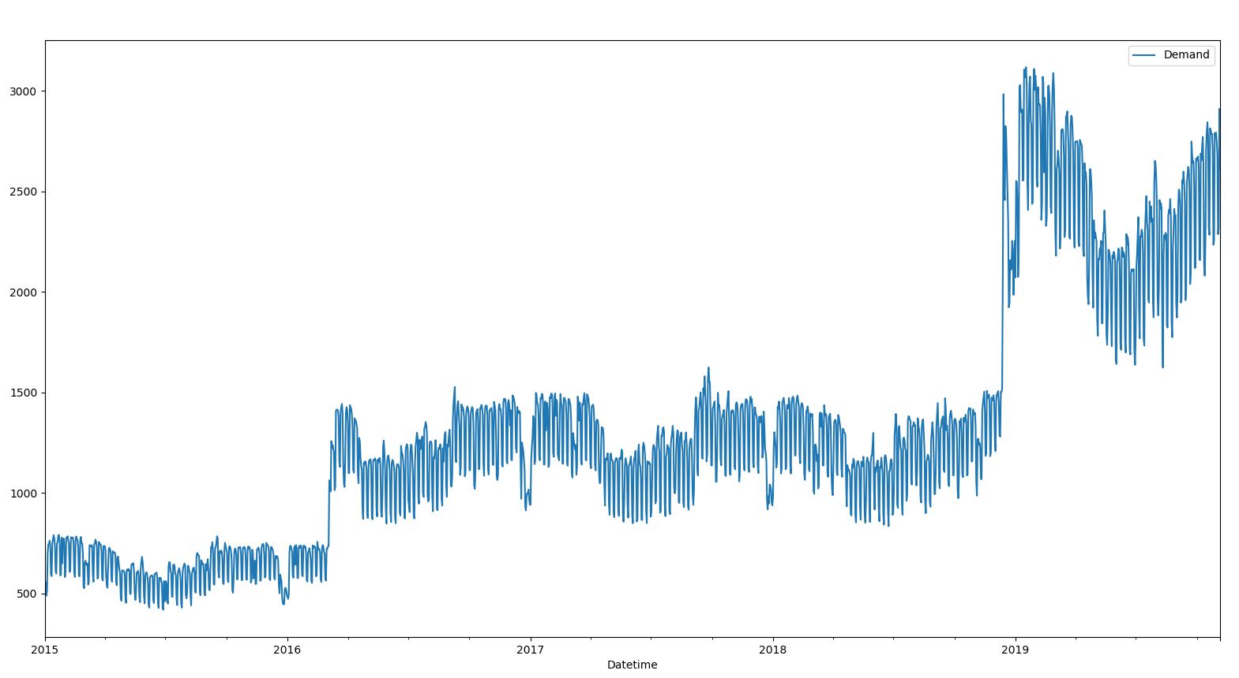
Dataset
The time series data was gotten from ‘Primary A lagged demand’ feeder at UNB. The data contains the power demand at a 15 mins interval starting from ‘2014-03-20 07:30:00’ until ‘2019-11-05 10:15:00’.
There was a huge gap in the 2014’s data, so only data from 2015 was used. I resampled the data to be the daily mean.

Slide 7
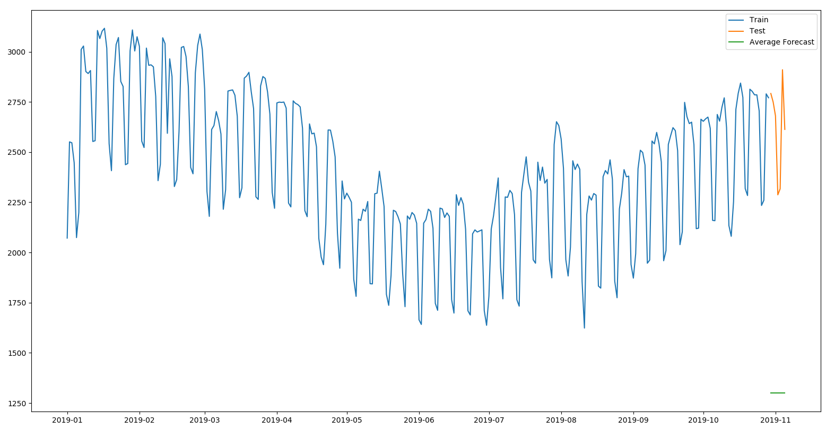
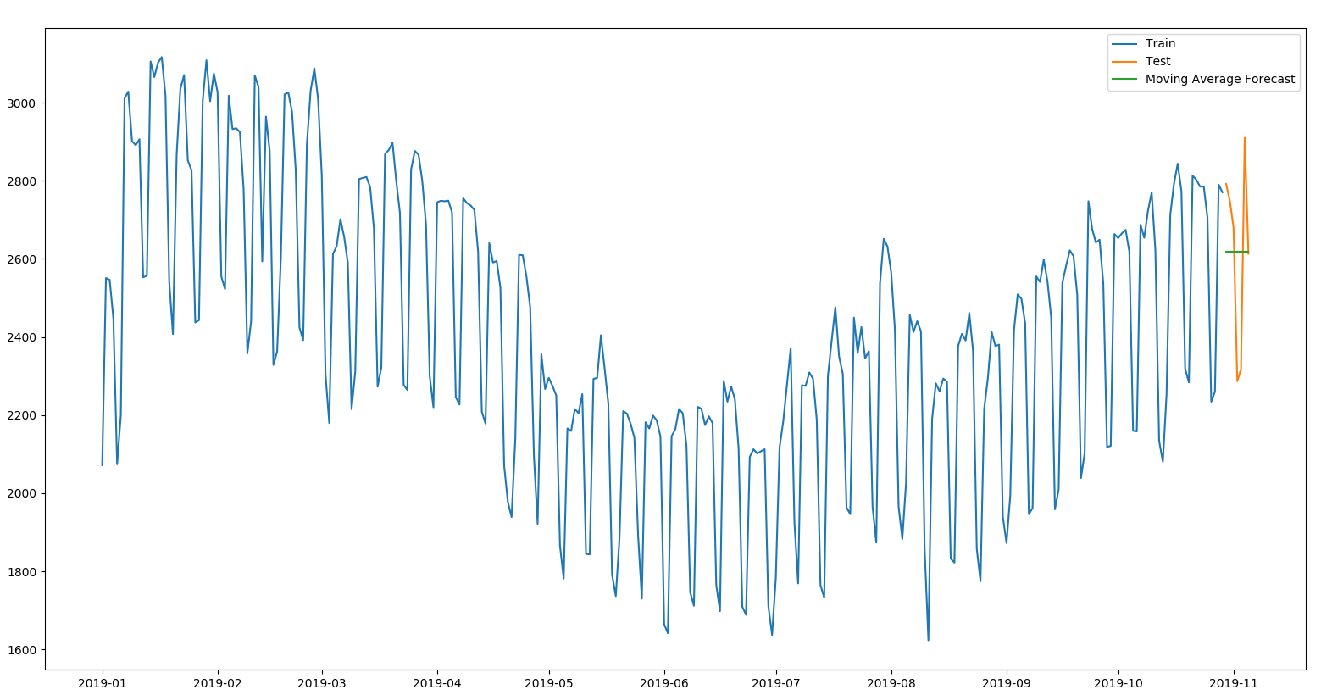
One Week’s forecast
The training data contained the data from 2015 still the last 7 days of the data (data[2015: len(data) - 7]), and the testing data contained the last 7 days of the data.
Simple Average Approach Moving Average Approach

Slide 8
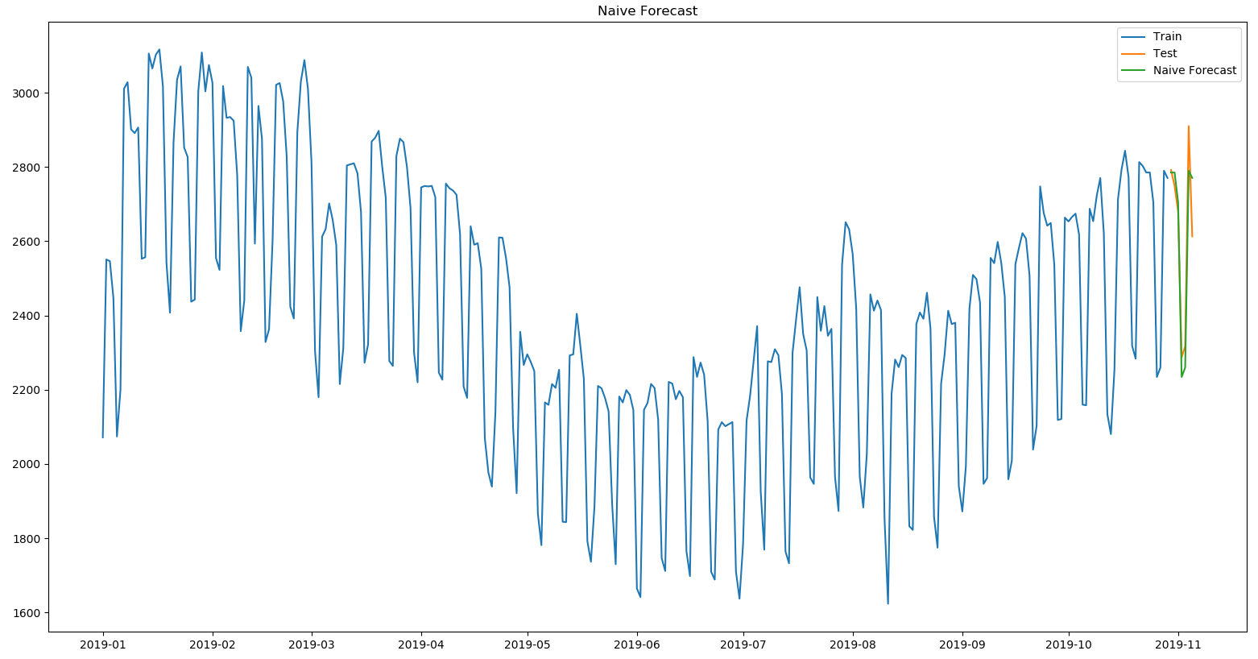
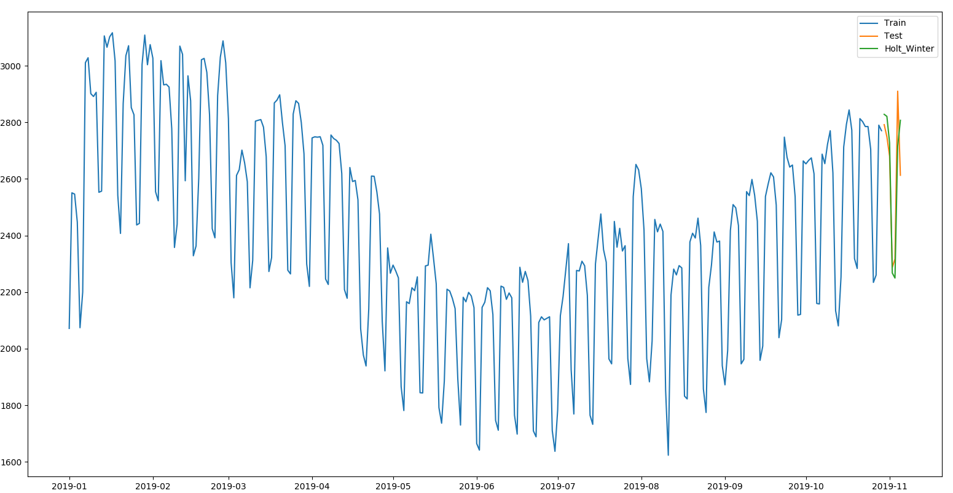
One Week’s forecast
The Naive approach Holt-Winter Method

Slide 9
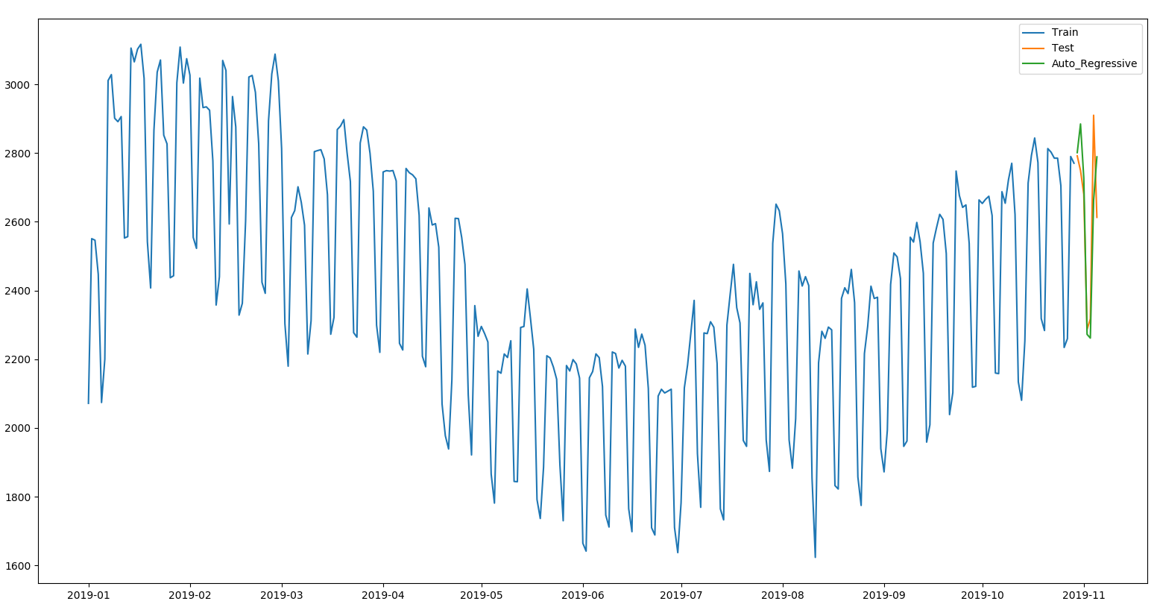
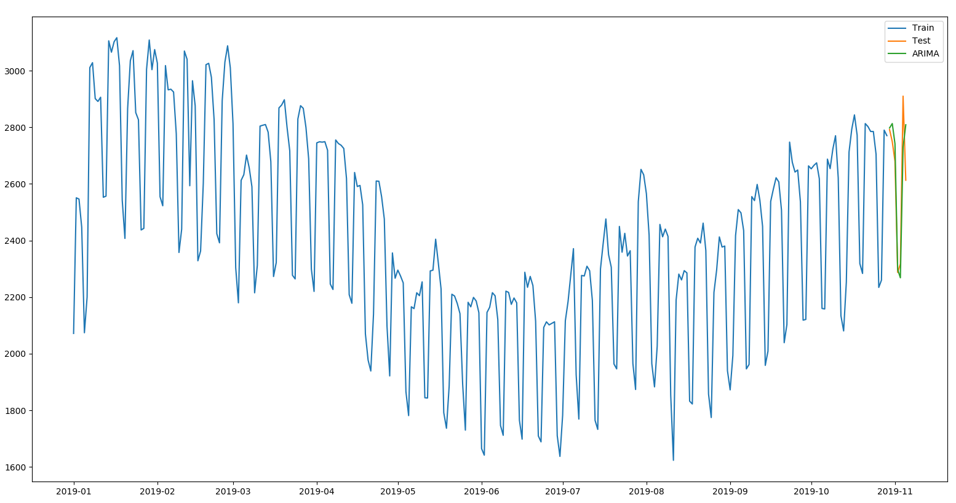
One Week’s forecast
Autoregressive Model ARIMA model

Slide 10
One Week’s forecast
In the one week’s forecast; the naive approach had the best performance, followed by the ARIMA model, and the Holt-Winter’s method. The naive method performed best because there is a high similarity between the test week’s demand and the previous week’s demand.
 | Simple Average | Moving Average | Naive Approach | Holt-Winter | AR model | ARIMA model
MAPE (%) | 50.08 | 7.28 | 2.49 | 3.37 | 3.62 | 3.02
ME (Kw) | -1322.25 | -2.69 | -2.69 | 9.74 | 7.21 | 15.48
MAE (Kw) | 1322.25 | 185.05 | 65.04 | 90.14 | 98.05 | 81.15
MPE (%) | -50.08 | 0.63 | -0.13 | 0.38 | 0.32 | 0.64
RMSE (Kw) | 1340.30 | 219.25 | 82.20 | 112.82 | 128.86 | 107.95

Slide 11
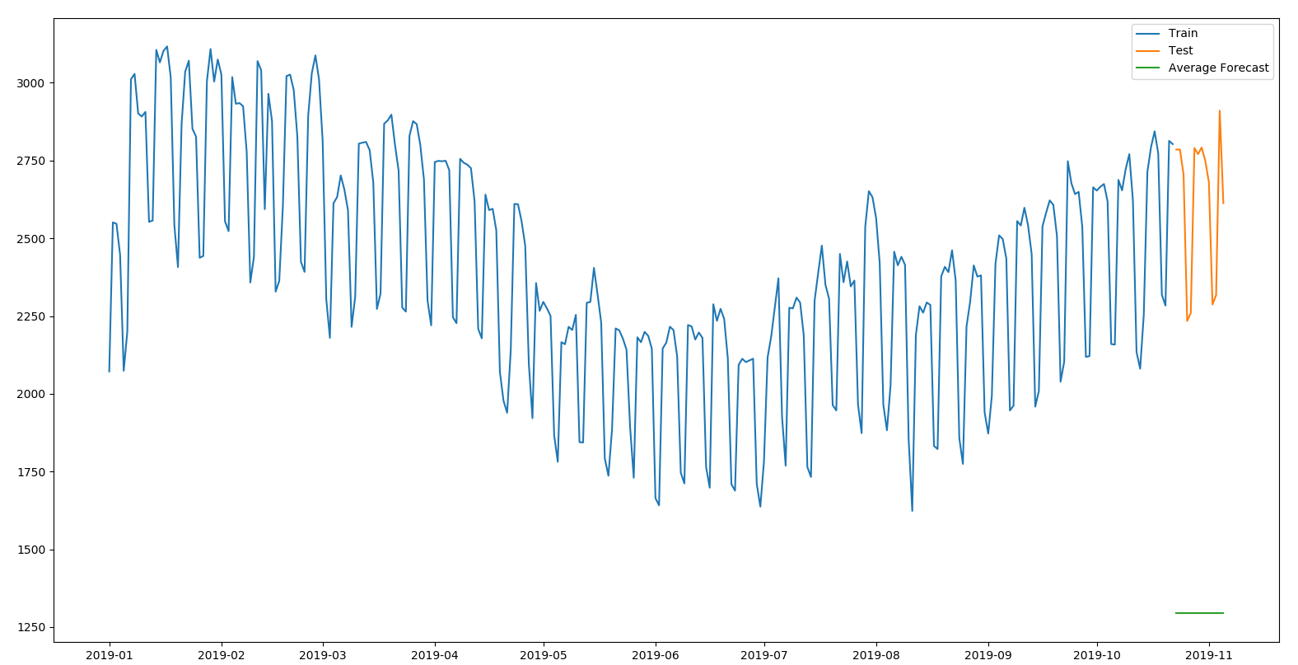
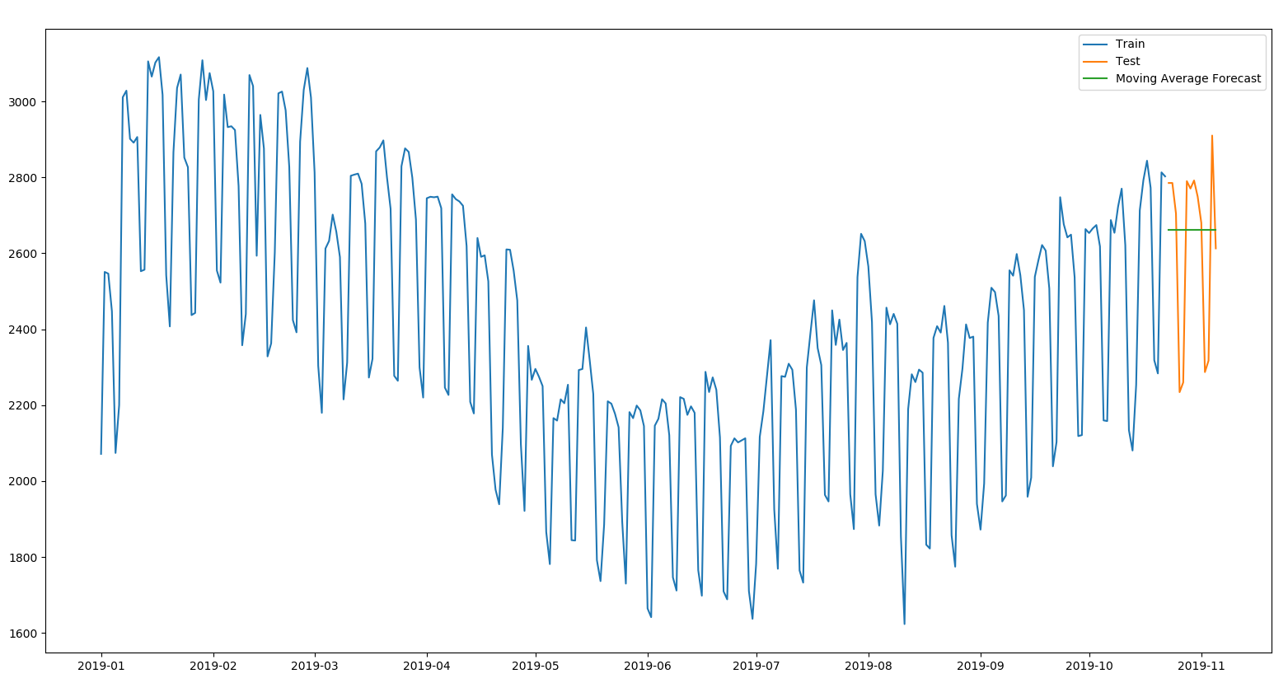
Two Weeks forecast
The training data contained the data from 2015 still the last 14 days of the data (data[2015: len(data) - 14]), and the testing data contained the last 14 days of the data.
Simple Average Approach Moving Average Approach

Slide 12

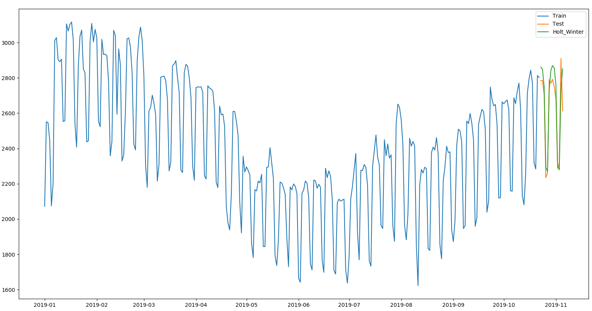
Two weeks forecast
The Naive approach Holt-Winter Method

Slide 13
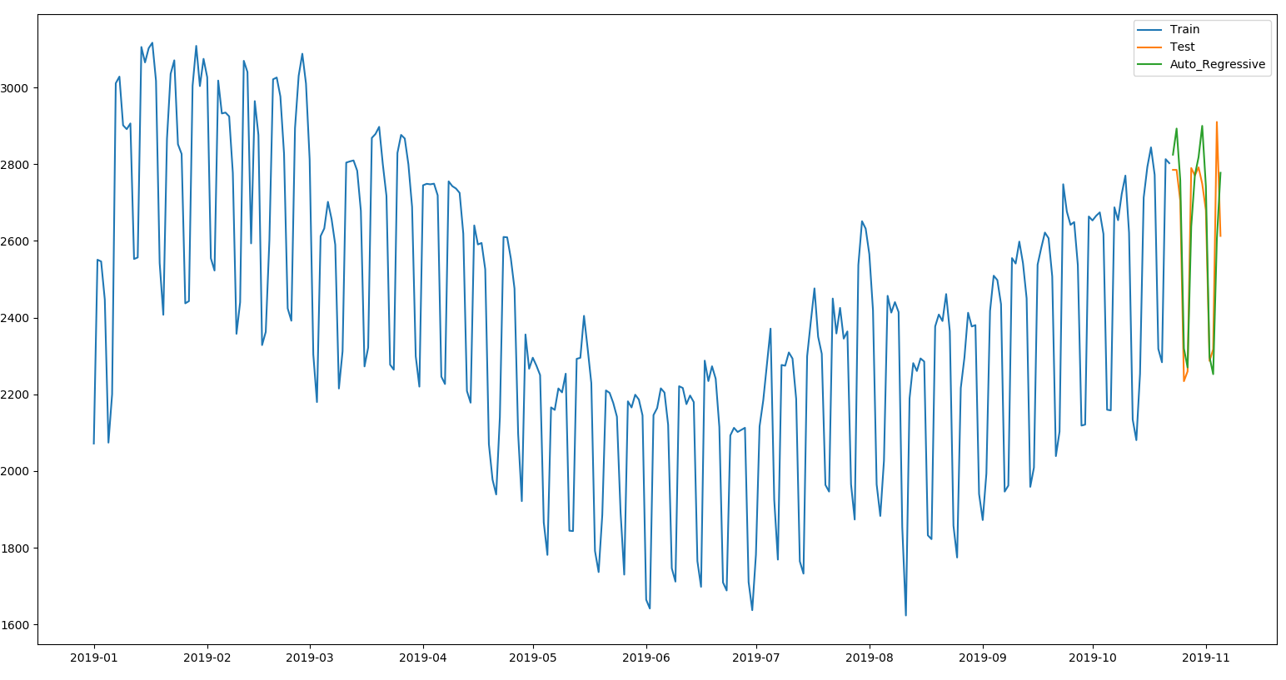
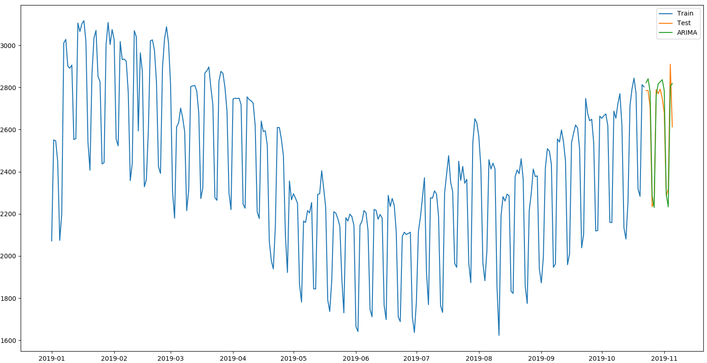
Two weeks forecast
Autoregressive Model ARIMA model

Slide 14
Two weeks forecast
From the table below; we can see that the Naive approach had the best performance for the second time in a row, with ARIMA and Holts-Winter method staying as the second and third best in a row respectively. As the horizon gets wider, the naive forecast may not be efficient anymore.
 | Simple Average | Moving Average | Naive Approach | Holt-Winter | AR model | ARIMA model
MAPE (%) | 50.22 | 7.58 | 2.29 | 2.95 | 3.28 | 2.58
ME (Kw) | -1326.17 | -41.06 | 41.06 | 41.24 | 13.46 | 32.54
MAE (Kw) | 1326.17 | 186.57 | 59.73 | 79.04 | 88.27 | 67.98
MPE (%) | -50.22 | 2.40 | 1.60 | 1.59 | 0.59 | 1.21
RMSE (Kw) | 1345.64 | 231.76 | 76.62 | 97.99 | 119.33 | 83.32

Slide 15
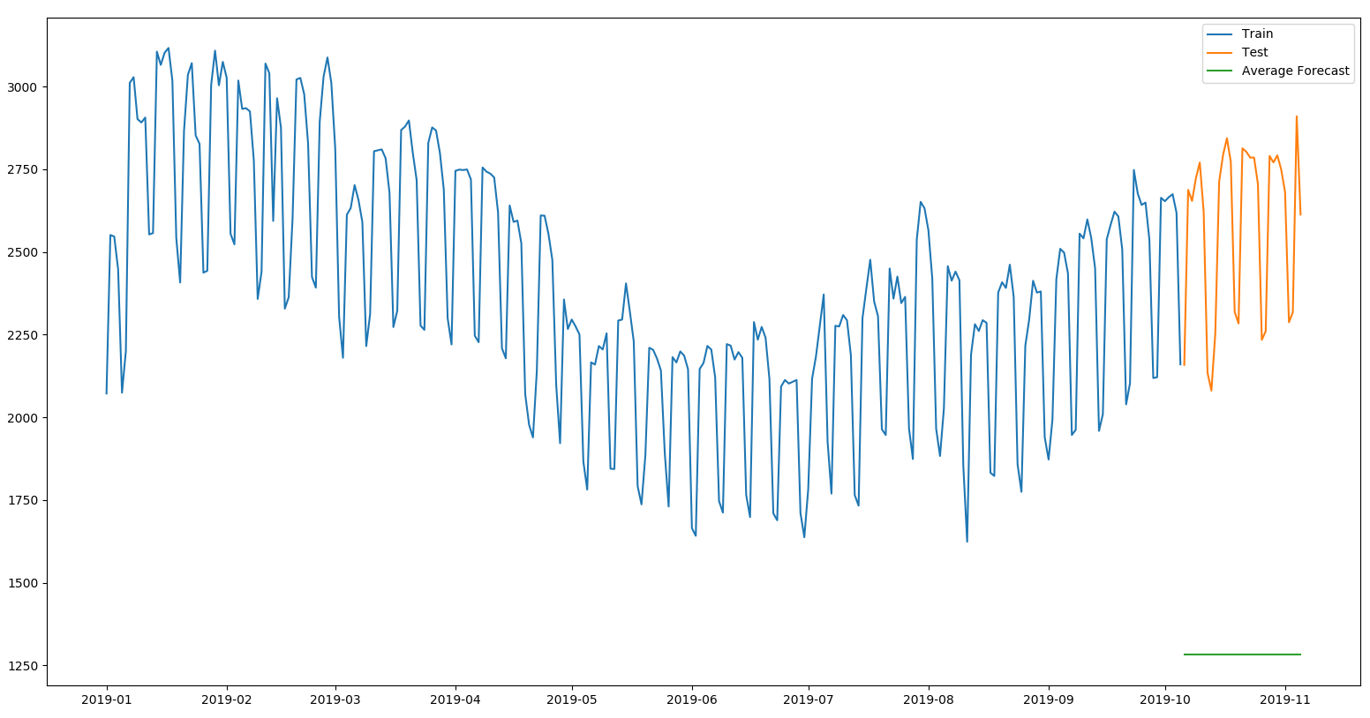
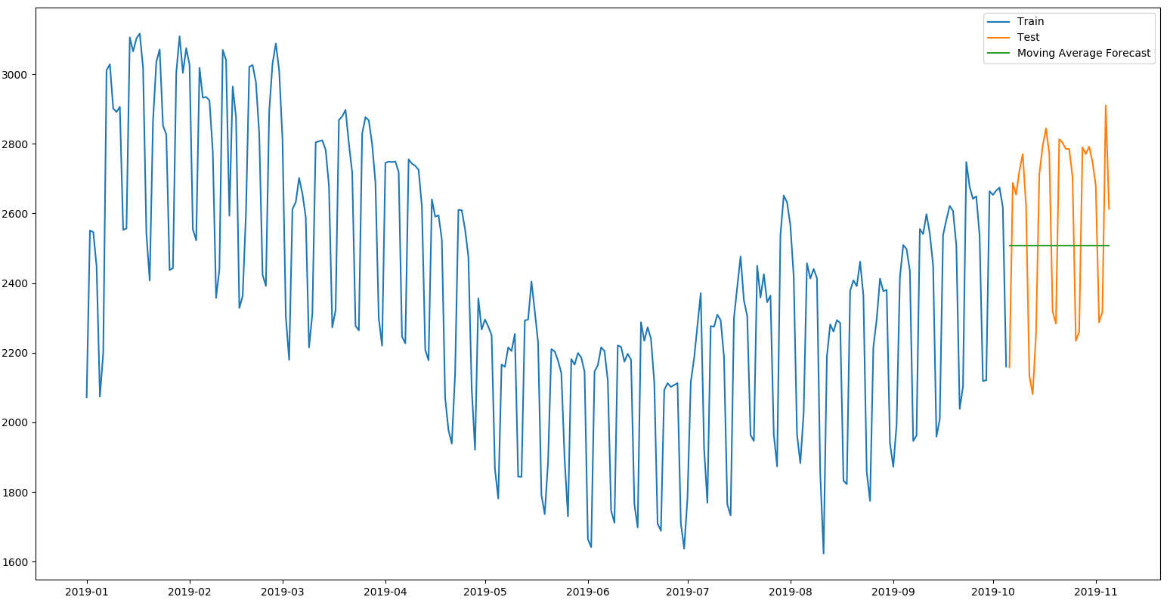
One Month forecast
The training data contained the data from 2015 still the last 31 days of the data (data[2015: len(data) - 31]), and the testing data contained the last 31 days of the data.
Simple Average Approach Moving Average Approach

Slide 16
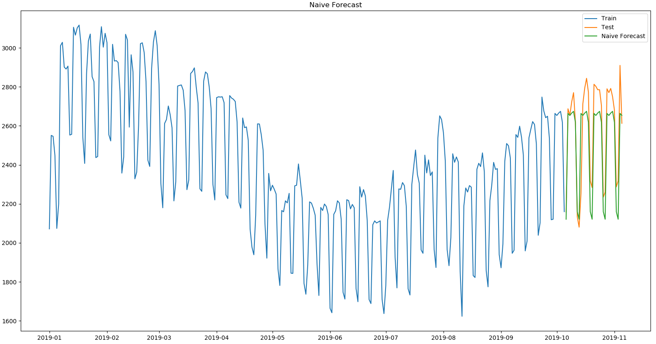
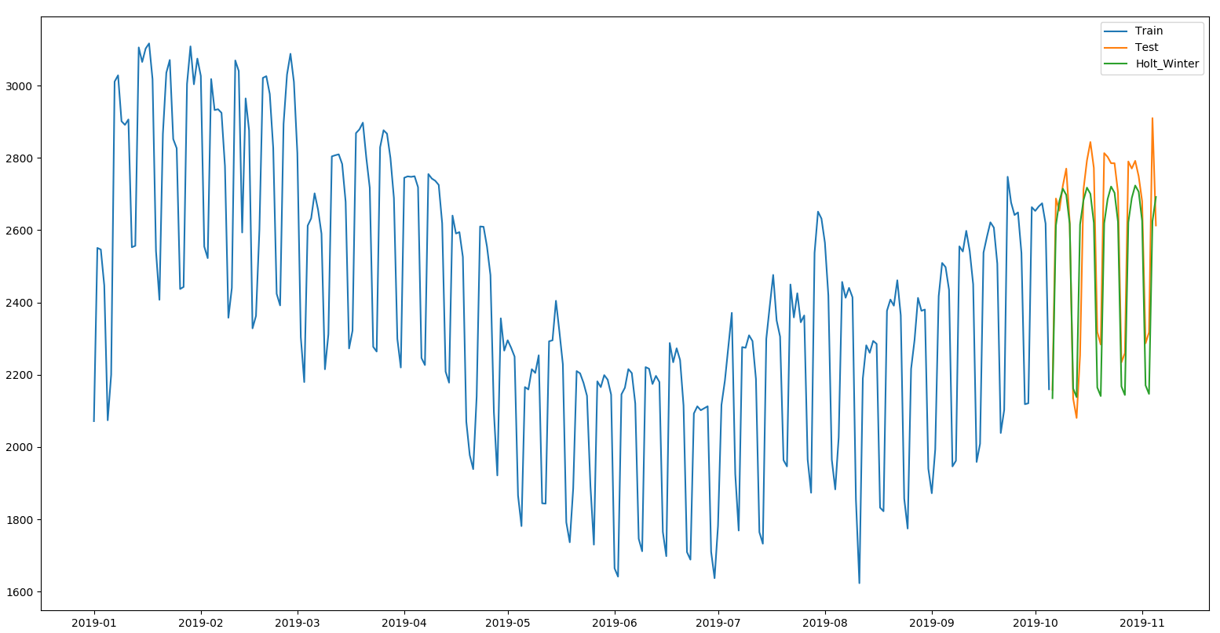
One Month forecast
The Naive approach Holt-Winter Method

Slide 17


One Month forecast
Autoregressive Model ARIMA model

Slide 18
One Month forecast
From the table below; we can see that the Naive approach wasn’t in the top three in this case. This is because of the wider horizon of a month. The ARIMA model was the best in the case, followed by the Holt-Winter’s method, the AR model, and then the Naive approach.
 | Simple Average | Moving Average | Naive Approach | Holt-Winter | AR model | ARIMA model
MAPE (%) | 49.89 | 9.97 | 4.38 | 3.97 | 4.24 | 3.12
ME (Kw) | -1302.46 | -75.89 | -78.66 | -65.64 | -58.14 | -35.87
MAE (Kw) | 1302.46 | 253.51 | 112.01 | 101.31 | 108.85 | 79.48
MPE (%) | -49.89 | -1.92 | -2.90 | -2.41 | -2.03 | -1.23
RMSE (Kw) | 1326.85 | 264.37 | 137.33 | 127.41 | 135.66 | 109.16

Slide 19
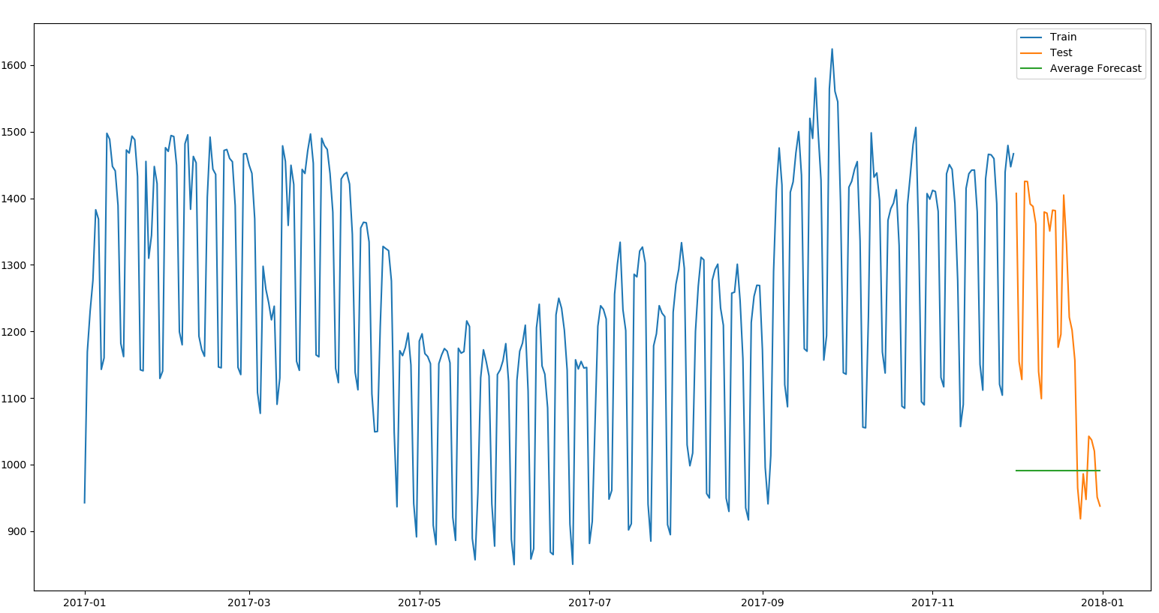
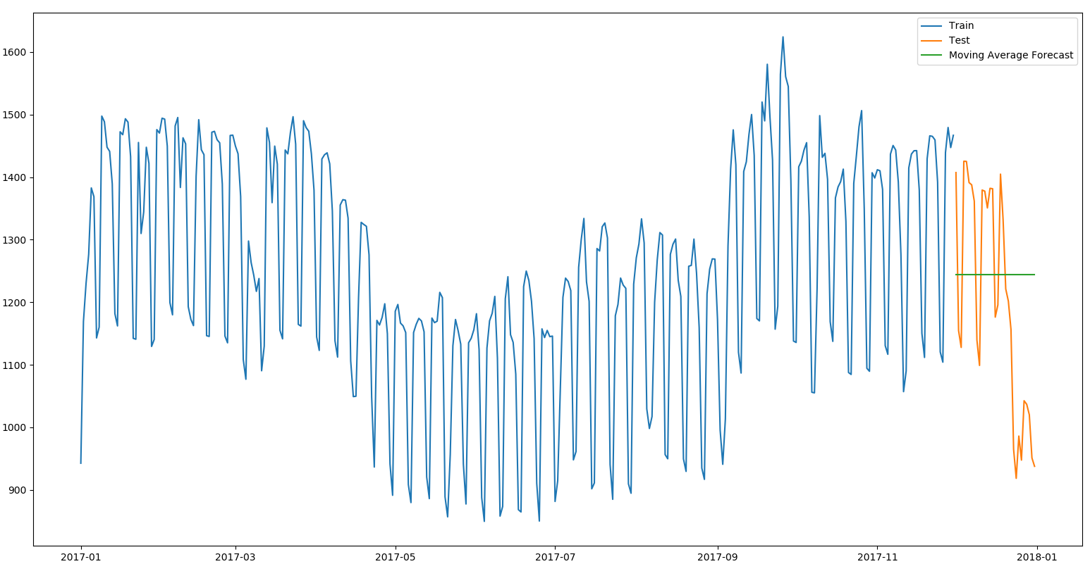
December, 2017’s forecast
First, I had to split the data into two; one for training, and one for testing. The training data contained the data from 2015 still the end of November 2017, and the testing data contained December, 2017’s data.
Simple Average Approach Moving Average Approach

Slide 20
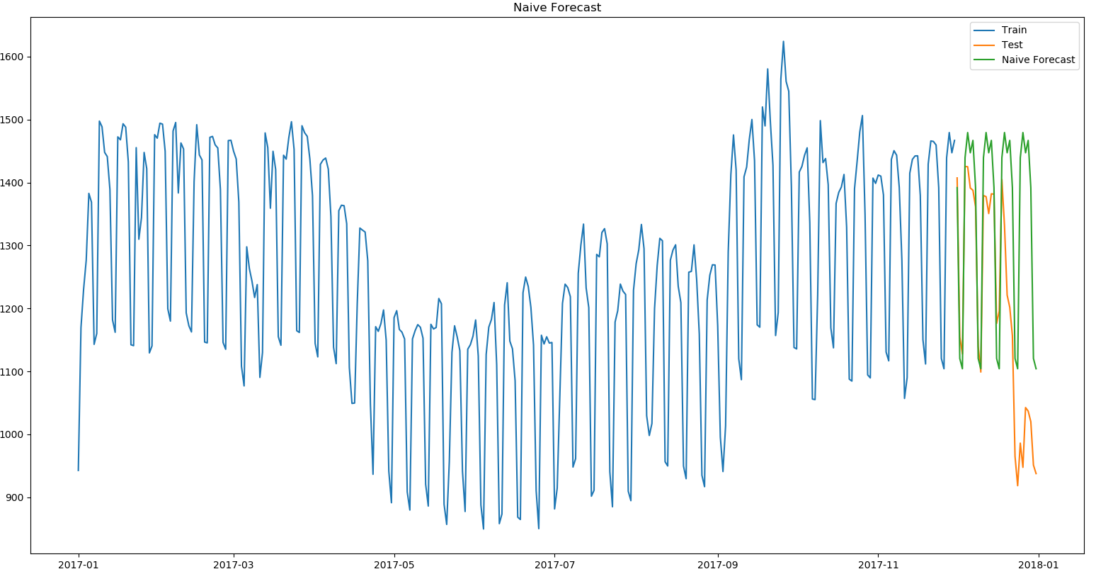
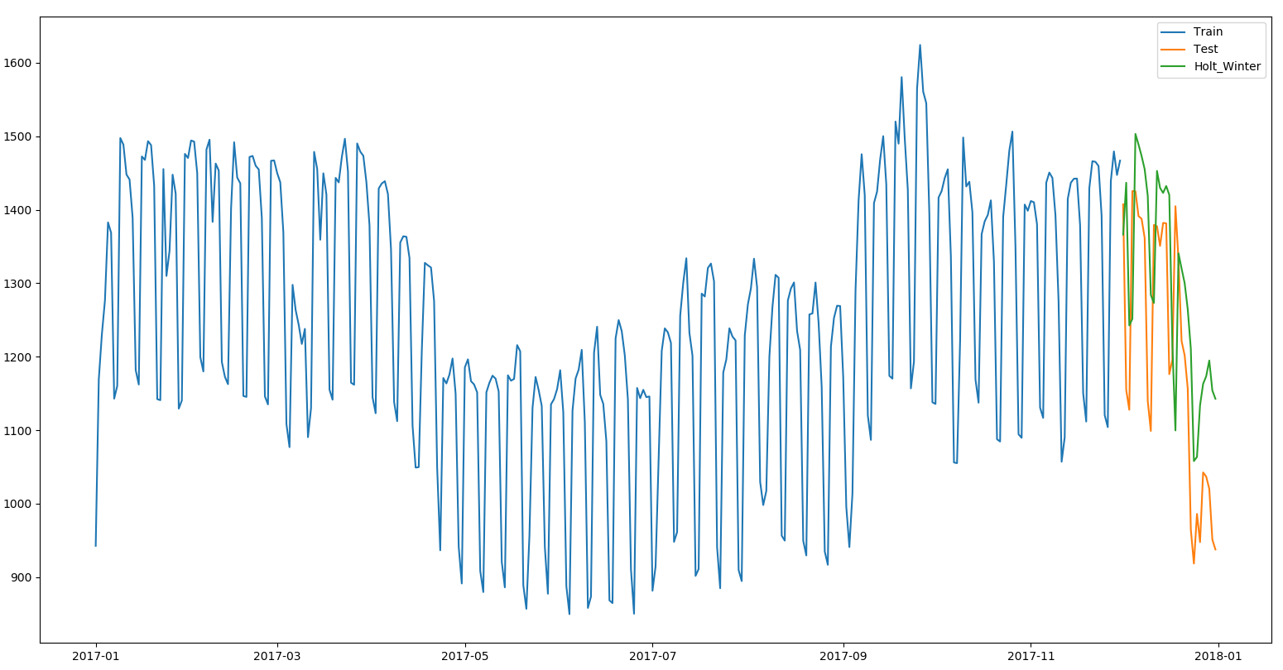
December, 2017’s forecast
The Naive approach Holt-Winter Method

Slide 21
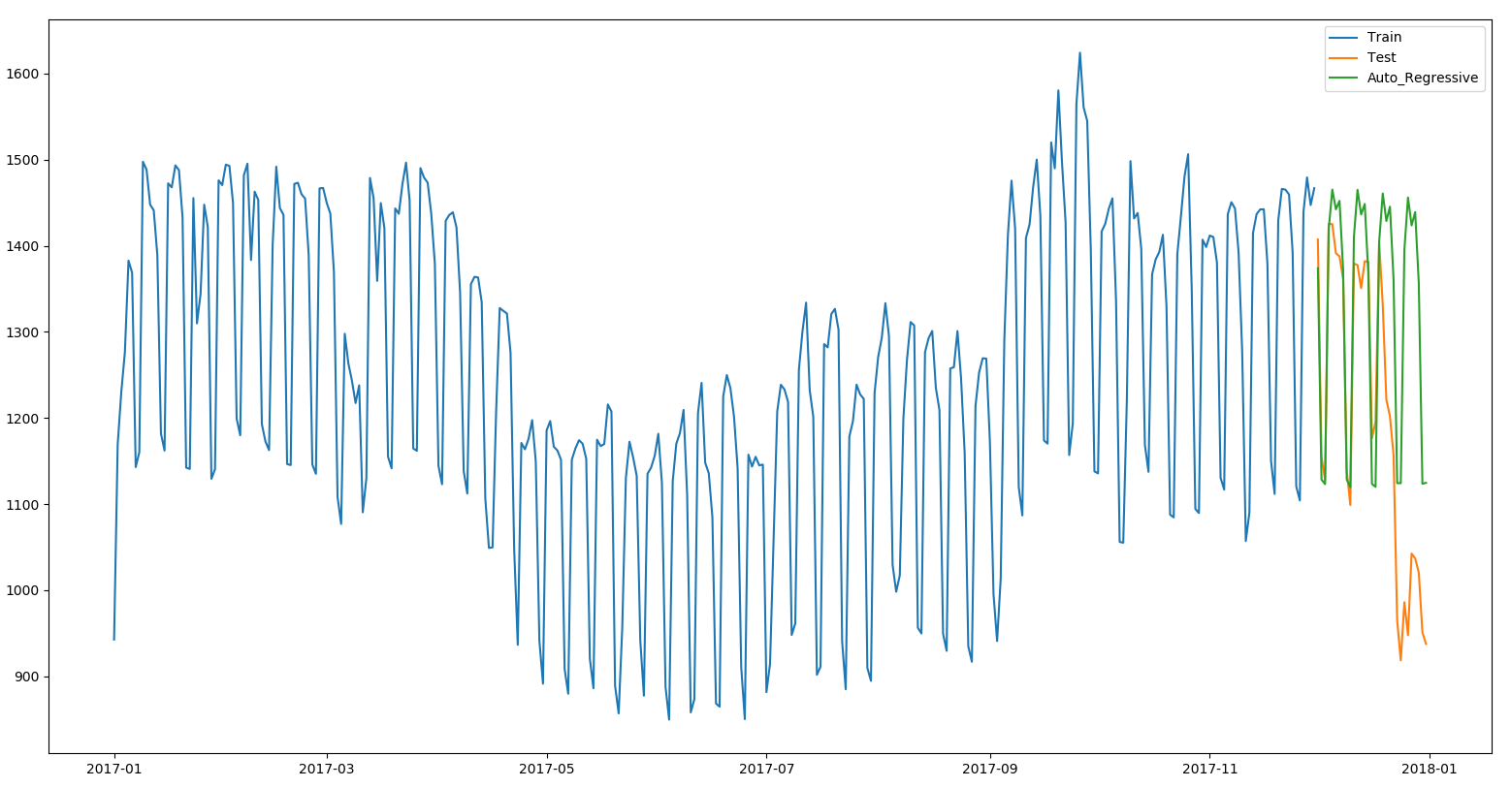
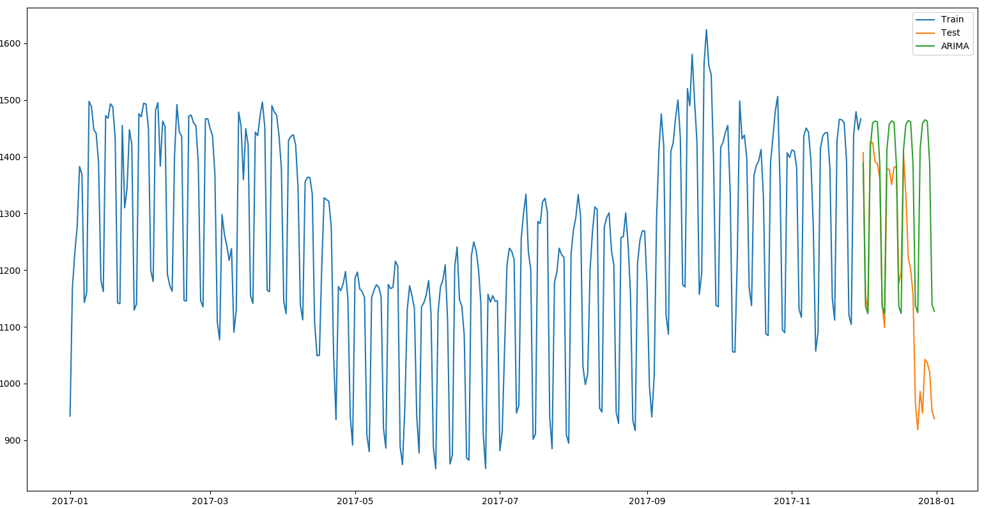
December, 2017’s forecast
Autoregressive Model ARIMA model

Slide 22
December, 2017’s forecast
Due to the sudden change in demand in UNB as Christmas holidays approaches; I decided to test the models on December, 2017 prediction. The results gotten was expected because it is a pretty difficult to predict this time period accurately. Based on the rmse values; the Holt-Winter model had the best performance in this case, followed by the Moving Average, AR and the ARIMA model.
 | Simple Average | Moving Average | Naive Approach | Holt-Winter | AR model | ARIMA model
MAPE (%) | 17.43 | 14.24 | 13.82 | 11.81 | 12.81 | 13.55
ME (Kw) | -211.95 | 41.09 | 133.26 | 93.69 | 121.94 | 133.83
MAE (Kw) | 227.37 | 159.60 | 148.71 | 134.11 | 136.43 | 144.65
MPE (%) | -15.79 | 5.71 | 12.52 | 8.94 | 11.63 | 12.66
RMSE (Kw) | 274.12 | 178.63 | 208.55 | 155.35 | 195.06 | 206.81

Slide 23
Challenges / Observations
The first challenge of this experiment was to get enough data that would help to train the model much better, and then removing outliers in the data.
Another challenge was to find an efficient model for predicting different horizons, as different models perform better with different dataset.
The simple average model works better if the average across the dataset remains the same. The moving average model could be improved by adding weights to the previous values being used for prediction, which could be time consuming.
The naive approach works best if the previous week was similar of close with the tested week; but if there are trends in the data and stationarity is lost, the naive approach become inefficient as the horizon gets wider.
The major challenge with the ARIMA model was to find the right parameters to use in training the model, as different horizons and dataset work best with different parameters.

Slide 24
Conclusions
The aim of this project was to test different models and see how well they perform on different horizons; one week, two weeks, one month, and December, 2017 forecasts.
In the one and two weeks forecast; the naive approach had the best performance, this is due to the high similarity in the data on a weekly basis. Due to the non-stationarity in the data, the naive approach becomes inefficient with a wider horizon.
In the one month forecast; the ARIMA model had the best performance, which is expected because ARIMA combines three methods (Auto regression, Integration, and Moving Average).
In December, 2017’s forecast; the Holt-Winter model had the best performance after I changed the seasonality period to 365 days.
For future work; I aim at adding other variables that affect demand like Temperature, and Dew Point. I believe this would improve the accuracy of the models.

Slide 25
Thank you for your attention!

